Slide 1
Version Control System
Yash Bedi
Software Engineer-iOS

Slide 2
Outline
Definition
Available Softwares for Source Control
What is the need of Version Control/Source Control ?
  Benefits
Basic Commands
Leveraging the power of git .diff files.
  Benefits
Intermediate Commands
  Extending rebase with an example.
Git tags + Benefits
Best Practices
  While doing a commit
  DO NOT commit
Tools and Apps
Miscellaneous
Appendix

Slide 3
The Definition
A system that records changes to
a file
over time,
so you can recall
specific versions later.

Slide 4
Available Softwares for Source Control
Git (Linus Torvalds - 2005)
Apache Subversion
Mercurial
Azure DevOps Server
Concurrent Versions Systems
Microsoft Visual SourceSafe
IBM’s Rational ClearCase
Adobe Version Cue

Slide 5
What’s the need of
Version Control aka
Source Control ?

Slide 6
Discussions.!!!

Slide 7
Benefits :
Backup and Restore
Sync with multiple computers
Working in a team
Safely create and test new features
Ownership + Credits + Blame

Slide 8
Basic Commands of Git
git init <project name> - Initialises a new repo.
git status - Gives you list of modified/added files locally.
git add <filename> - Adds the file to the staging area.
git commit -m “message”- Commits all files added to staging area.
git diff <filename> - Lists the changes made to the file when compared to the HEAD version.
git checkout [-b] <branch name> - Switches the branch. The -b parameter will create a new branch.
git stash - Backs up any local changes made.
git stash apply - Restores the most recently backed up files.
git pull - Pulls the latest changes from the remote repo.
git reset HARD - Removes all the local changes made to file.
git push origin - Pushes local changes to remote repo.
git rm <file name> - Used to remove a file from a Git repo.

Slide 9
Discussions.!!!

Slide 10
Leveraging the power of git .diff files !!!

Slide 11
Benefits :
A patch is a small file that indicates the changes made in a repository.
It's generally used when someone from outside your team has read-only access but had a good code change available. He then creates a patch and sends it to you.
You apply it and push it to the git repository.
Everyone then benefits from the updated version, and the author of the patch didn't need read/write access.
Also to setup a testing environment with just couple of clicks.

Slide 12
Demo (Sort off..)!!!

Slide 13
Intermediate Commands:
git tag <tagname> - Tags are ref’s that point to specific points in git history.
git merge - Join two or more histories together.
git cherry-pick - Picking arbitrary commits by reference and appended to current working head.
git rebase -i ~<number of commits/commit hash> - Combining commits to make git log more concise. -i is to make the rebase interactive
below are the commands:
p , pick - use commit
e , edit - use commit but stop for amending
d , drop - remove commit
s , squash - use commit, but meld into previous commit.

Slide 14
Example for git rebase :
* 44d2565 (HEAD -> home_page, master) Create nav border
* 1bd999c Styling user data WIP. Add margin
* a135e04 Implement search input for user display
* 76e5811 Add padding to nav list items
* 97178bd User data display WIP
* c289adc Create div for user data
* 14a64ff Add background color to nav and body
* 83c9bbb Add list items to nav
* 60042c8 Add nav to application
* c0fa78d Initial commit

Slide 15
Example for git rebase :
git rebase -i HEAD~9
or
git rebase -i HEAD 60042c8

Slide 16
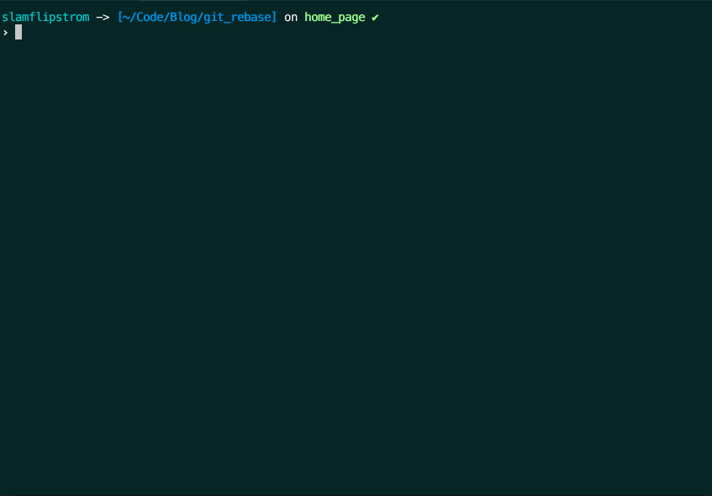
Example for git rebase contd. :

Slide 17
After using git rebase the new commit history looks like this :
* ca22552 (HEAD -> home_page) Add home page to website
* c0fa78d Initial commit

Slide 18
Discussions.!!!

Slide 19
Benefits of using git tags :
Git tags are really useful to archive code base related to a specific release version.
Suppose, you are the delivery manager to finally push the code to Heroku Continuous Integration (Heroku CI) server using git push heroku master and finally deploy that using heroku open.
Congratulations!!🤝🤝 your have successfully deployed v0.0.1.
Wait🧐🧐, do you need a backup of this code base?
Because next time when you will publish v0.0.2 and so on, it will be hard to hop from one commit to another to get the production code base for each version. Using tag s can help you a lot.
So, when you deploy a version of your application, you can archive that codebase by creating a new tag.

Slide 20
Discussions.!!!

Slide 21
Best Practices !!!

Slide 22
While doing a commit :
Fixing two bugs = Two separate commits.
Small commits = Easy to [understand, roll back ], less conflict.
Write a good commit message, think twice before hitting the commit button.
Imperative present tense: “added” -> ❌ , “adding” -> ❌, “add” -> ✅.
Limit commit messages to ~50 words.
Always think these 3 before commiting: Why ? How ? What ?
Follow YAGNI principle.
Always review your code before the commit.

Slide 23
While doing a commit contd. with an eg.:
If applied this commit will ____________
Refactor subsystem X for readability
Update getting started documentation
Remove deprecated methods
Release version 1.0.0
Merge pull request #123 from user/branch

Slide 24
DO NOT commit ❌:
Broken code
Something that’s half done
Untested work
A piece of code which is to be sent in a different PR or commit, do not club it with the current one, if your team is not going to need it now.

Slide 25
A diff will tell you what changed, but only commit message can properly tell you why.
Peter Hutterer

Slide 26
Tools & Apps
gityapp.com
git-tower.com
sourcetreeapp.com
gitboxapp.com
Github Desktop
TortoiseGit

Slide 27
Miscellaneous
Never push a keyphrase, password, key, secret etc. to Remote. ❌
Close all comments BEFORE getting your PR merged
Prefer merging branch1 to branch2 or vice-versa. Taking pull from a different branch to your current branch will attempt to merge remote’s master to yours.
Use git log --oneline instead of git log.
You can filter commits even by date, author, time, file content etc.
Deleting multiple branches: git branch -d branch1 branch2 branch3
Discussing Size issues, solving Merge conflicts.

Slide 28
Appendix:
https://blog.sourcetreeapp.com/2013/03/28/sourcetree-for-mac-1-6-beta/
https://www.atlassian.com/git/tutorials/inspecting-a-repository/git-tag
https://medium.com/@slamflipstrom/a-beginners-guide-to-squashing-commits-with-git-rebase-8185cf6e62ec
https://en.wikipedia.org/wiki/Version_control
https://www.atlassian.com/git/tutorials/cherry-pick
https://stackoverflow.com/questions/8279602/what-is-a-patch-in-git-version-control
https://www.atlassian.com/git/tutorials/what-is-git
https://superuser.com/questions/163033/pull-for-another-git-branch-without-switching
https://hackernoon.com/ten-useful-git-log-tricks-7nt3yxy
https://medium.com/@sauvik_dolui/a-few-git-tricks-tips-b680c3968a9b

Slide 29

Thank you!
Yash Bedi
yash.bedi@paytm.com

